Slide 1
STEM Salaries in US
By MSBA Group 1
Sandhya, Sneha, Sumei, Tejaswini, Yuxin
Notes:
Think it would be relatable. What all our efforts comes to eventually. :) We hope you get some few insights on future STEM careers.

Slide 2
What we are going to talk about:
Data Overview
Data Description
Data Cleaning brief
Three Key Insights:
Is a Masters or PhD worth it?
Is Loyalty to a company a reward or penalty?
Is there really a gender pay gap in STEM field?
Data Science Career [Extra]
Q&A
Notes:
In the next 10 min, we will talk about...

Slide 3
Data Description
Source: Kaggle - Data Science & STEM Salaries, scraped off from levels.fyi
 | Key Columns | Cleaning Brief
Demographic | Education, Gender, Race Location [city, state, country] | Location: Split to city, state and filtered US states into East Coast, West Coast, Central <region> column For ML, converted Education, Race & Region to dummies
Professional | Current Company, Job Title, Level, Years of Experience, Years at Company | For ML, we converted to dummies For insights and analysis, converted to categorical bins Dropped Level, since no golden standard
 | [in USD] Total Yearly Compensation, Base Salary, Bonus, Stock Grant | For ML, used as is For insights and analysis, converted to categorical bins
Other | Timestamp, rownumber, dmaid,tag | Dropped columns
Initially,
#Rows: 62642 & #Columns: 18
Finally,
#Rows: 52840 &
#Columns: 19
Notes:
Whole dataset, filtered for US alone

Slide 4
Insight #1:
Is a Masters or PhD worth it?
Notes:
Well, education is expensive. But, is it all worth it?

Slide 5
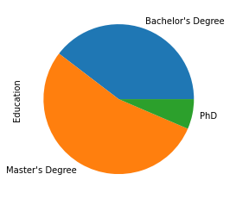
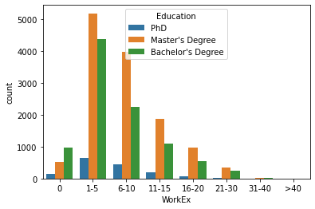
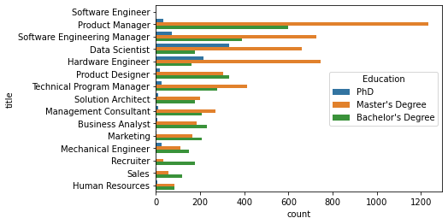
Quick Look on Education
50% records had education, of which >50% is Masters Degree
Role: As level of Education rises, people get into specialised technical fields Eg. most PhD only in Software, Hardware & Data Science
**30+ years of experience has <100 records. Removed for analysis.
*Software Engineer is highest, but numbers is removed because it was 4X higher and skewing the scale
Notes:
Alright, here’s A short data landscape on Education before we dive in to the insight!

Slide 6
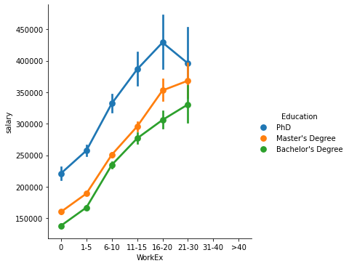
So, is a Masters or PhD worth it?
For Master’s, the salary is 10% higher than Bachelor’s on average, but there’s a 15% jump after 15 years of Work Experience
For PhD, the salary is 30% higher than Masters. Difference is not just in the beginning years, but even with higher experience.
cluster | Salary | Years of Experience | BachelorsDegree | Masters Degree | DoctorateDegree
2 | $823,811.09 | 15.13 | 0.110 | 0.222 | 0.080
3 | $447,412.24 | 11.77 | 0.127 | 0.248 | 0.062
0 | $270,385.53 | 9.02 | 0.142 | 0.265 | 0.042
1 | $152,788.16 | 5.02 | 0.215 | 0.231 | 0.016
Yes, it is worth it! For Masters, differentiation is more so in the long run. But, a PhD could catalyse the career throughout.
Notes:
The clustering data also shows a similar trend, where we see most people with the degree!

Slide 7
Insight #2:
Is Loyalty a reward or penalty?

Slide 8
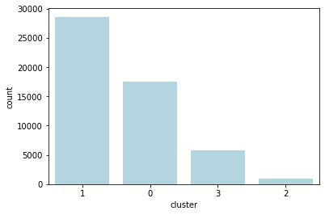
Quick Look on Clustering
Key Differentiator in clusters:
cluster | Yearly Salary | Years of Experience
2 | $823811.09 | 15.13
3 | $447412.24 | 11.77
0 | $270385.53 | 9.02
1 | $152788.16 | 5.02
As expected, #records in each higher salary band is decreasing
All clusters have >1000 records
 | Columns Used
Salary | base, bonus, stock grant
Work Ex | Years of Experience, Years at Company
Education | Masters_Degree, Bachelors_Degree, Doctorate_Degree
Location | region_Central, region_West, region_East
Gender & Race | gender_Female, gender_male, gender_Other, race_Asian, race_White, race_Black, Hispanic, Two or More
Notes:
To answer this question, we used Clustering.

Slide 9
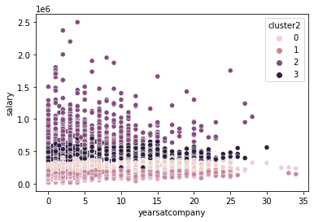
So, is Loyalty a reward or penalty?
cluster | Yearly Salary | Years of Experience | Years at Company
2 | $823811.09 | 15.13 | 4.5
3 | $447412.24 | 11.77 | 3.5
0 | $270385.53 | 9.02 | 3.2
1 | $152788.16 | 5.02 | 2.3
While overall Work Experience is highly correlated with salary (44%), there is only a 16% correlation between Years at a company and Salary.
No, not so rewarding! To earn more than $400K, move on to the next challenge after 3-5 years.

Slide 10
Insight #3:
Is there really a gender pay gap in STEM?

Slide 11
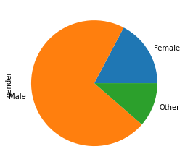
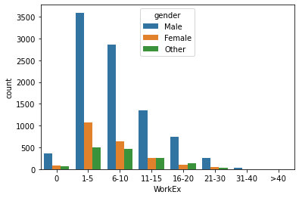
Quick Look on Gender Data
Normalizing for same Education and Work Experience levels.
Below data split for Masters Degree Students alone:
Nearly 70% is Male
Work Ex: Will focus on first 20 years of career, since the Female data becomes <100 post.
Notes:
Masters because more than 50% data is for that and well, we are doing Masters
Females reduce with higher WorkEx, especially > 20 years, while Males distribution is consistent, since most women would have started doing higher studies in STEM only recently.

Slide 12
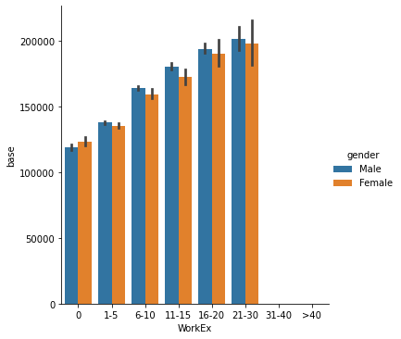
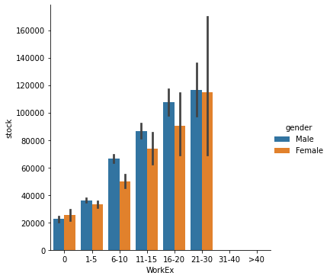
So, is there a gender bias in STEM?
Base Salary
Stock Grant
Only 5-8% difference
Nearly 20% difference!!
Yes, stock options cause the bias primarily. While the pay starts off on equal footing, men get ~18% more stock after 5+ years of Work Experience. Girls, negotiate better on stocks!
Notes:
Starts off around 130K, in fact women start off better. But, with higher work ex, difference increases

Slide 13
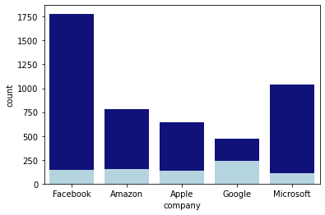
[Extra] How does a career in Data Science look like?
Data Scientists: Masters vs PhD
Good News: Right place to earn. West Coast earn more than East Coast. Again, the difference comes in stocks.
More Good News: Most major companies recruit more Masters candidates, compared to PhD. Although, Google is an exception.
Decreasing order of Yearly Compensation: Facebook > Google > Apple > Amazon > MS

Slide 14
Hope you got a STEM career perspective.
All the best!

